Slide 1

Deliver REST Endpoints at ease Using PowerShell and Node JS
Chendrayan Venkatesan (Chen V)
@ChendrayanV

Slide 2
PS C:\> WhoAmI
Chendrayan Venkatesan (Chen V)
CDM MVP | MCTS SharePoint | MCP Exchange | ITIL V3 Foundation
Twitter : @ChendrayanV
LinkedIn : https://www.linkedin.com/in/chendrayanv/
An IT Professional one who use PowerShell at workplace to solve customer requirements! Strongly believe in the saying “Learning is a continuous process!”

Slide 3
Agenda
Why not JS? Why PS?
Deep dive on reliability
Convert your solution as Microservices.
More on Demo!

Slide 4

Easy? Really? How? Show your Code!
I bet a beer! It’s that easy!

Slide 5
Inspired from……..
We Offer THREE kinds of service
GOOD-CHEAP-FAST
Pick any two
GOOD service CHEAP won’t be FAST
GOOD service FAST won’t be CHEAP
FAST service CHEAP won’t be GOOD
___________________________________________
☺ ☺ ☺

Slide 6
REST API
Representational State Transfer (REST)
A set of constraints and properties based on HTTP
Uniformed Interface]
Stateless and cacheable
Client-Server

Slide 7
API Introduction
Application Programming Interface
An Engine Under the Hood.
A messenger to convey our needs to system to get the job done!
Is a set of subroutine definitions, protocols and can be a tool for building applications.
A good API allows us to interact with a system in very easy manner.
It’s required for both IT Professionals and developers to work in any infrastructure for solving customer requirements.

Slide 8
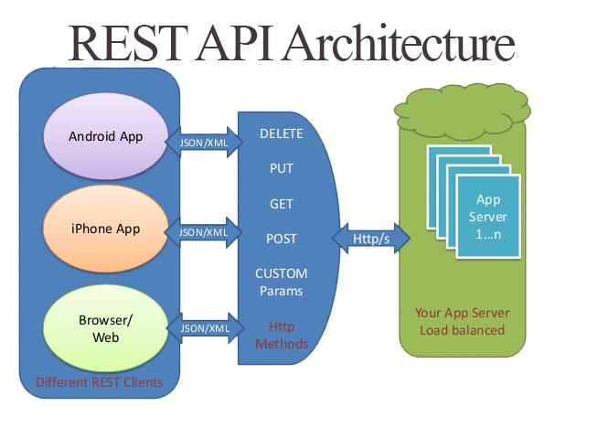
REST API | A View

Slide 9
Increase Productivity
Share your PS Script as REST endpoints for developers
Cross platform
Quick to build
Easy exception handling.

Slide 10
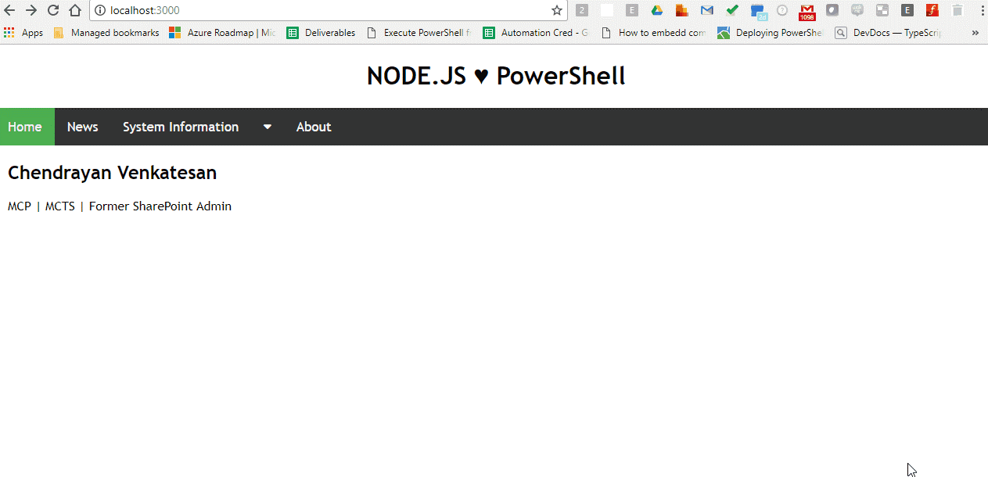
Our REST API endpoints

Slide 11
Demo

